Slide 1

Advantages and Disadvantages Essays

Slide 2
Advantages and Disadvantages Essays
The Question
Questions for IELTS advantages and disadvantages essays can be worded in several different ways. Here is some typical wording that might be used:
What are the advantages and disadvantages of….?
Do you think the advantages outweigh the disadvantages?
Discuss the advantages and disadvantages and give your opinion.

Slide 3
Advantages and Disadvantages Essays
IELTS advantages and disadvantages essay questions fall into two main categories:
Questions that ask for your opinion.
Questions that do not require you to state your opinion.
The first part of the question will always be a statement. You will then be asked to write about both the advantages and disadvantages of the idea stated. You may also be required to state your opinion.
Here are two more sample questions for illustration. For the first one, you must give your opinion but in the second, you should not.

Slide 4
Advantages and Disadvantages Essays
1. Small businesses are disappearing and being replaced by large multinational companies.
Do the advantages of this outweigh the disadvantages?
2. Most career choices demand vocational skills or specialist knowledge. However, despite this, most schools still teach academic subjects such as history or social studies.
Discuss the advantages and disadvantages of this.

Slide 5
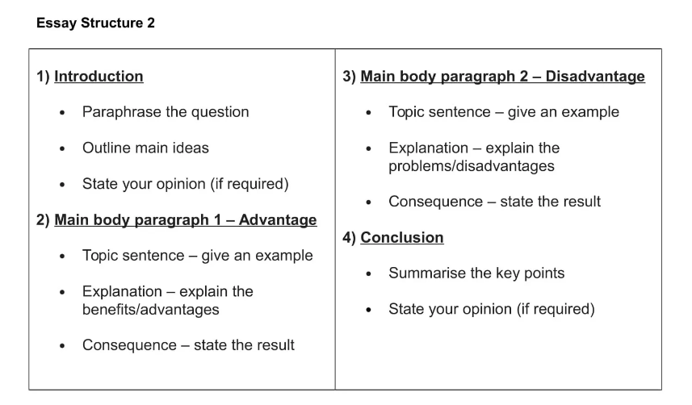
Advantages and Disadvantages Essays

Slide 6
Advantages and Disadvantages Essays
The keywords in the question tell you the specific topic your essay must be about.
A lot of places in the world rely on tourism as a main source of income. Unfortunately, tourism can also be a source of problems if it is not well-managed.
What are the advantages and disadvantages of tourism in the modern world? Do you think that the benefits of tourism outweigh its drawbacks?

Slide 7
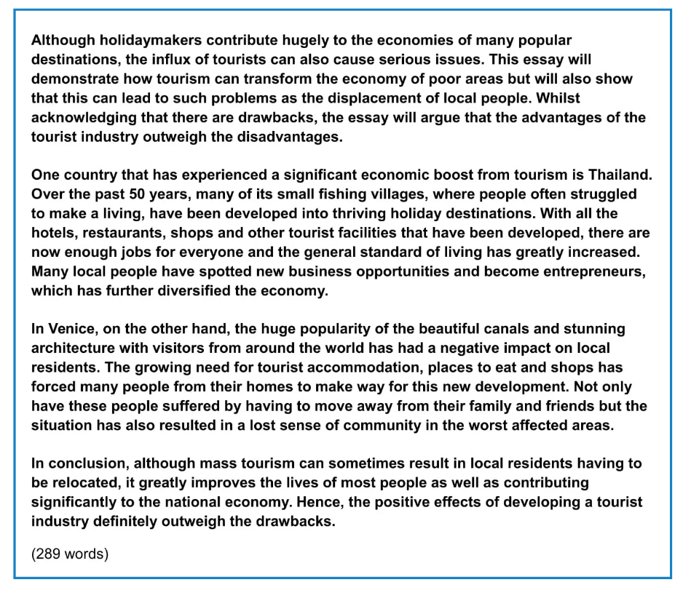
Answer

Slide 8
BREAKDOWN AND EXPLANATION

Slide 9
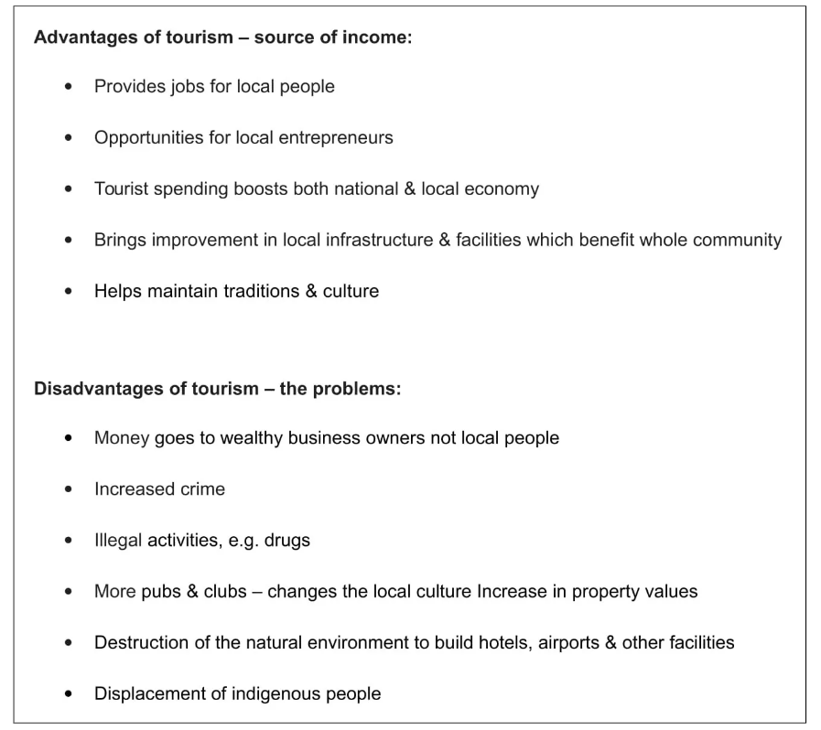
Ideas

Slide 10
Introduction
Question: A lot of places in the world rely on tourism as a main source of income. Unfortunately, tourism can also be a source of problems if it is not well-managed.
Paraphrased question:
Although holidaymakers contribute hugely to the economies of many popular destinations, the influx of tourists can also cause serious issues.
Outline statement:
This essay will demonstrate how tourism can transform the economy of poor areas but will also show that this can lead to such problems as the displacement of local people.
Advantage – Poor areas are now prosperous tourist resorts
Disadvantage – Displacement of local people
Opinion statement:
Whilst acknowledging that there are drawbacks, the essay will argue that the advantages of the tourist industry outweigh the disadvantages.
*influx-an arrival or entry of large numbers of people or things.
DO NOT GIVE ANY HEADING
THE HEADINGS OF THE PARAGRAPHS ARE FOR EXPLANATION ONLY
YOUR WRITING SHOULD ONLY HAVE PARAGRAPHS AS SHOWN IN THE LAST SLIDE

Slide 11
Introduction
Question: A lot of places in the world rely on tourism as a main source of income. Unfortunately, tourism can also be a source of problems if it is not well-managed.
Although holidaymakers contribute hugely to the economies of many popular destinations, the influx of tourists can also cause serious issues. This essay will demonstrate how tourism can transform the economy of poor areas but will also show that this can lead to such problems as the displacement of local people. Whilst acknowledging that there are drawbacks, the essay will argue that the advantages of the tourist industry outweigh the disadvantages.
DO NOT GIVE ANY HEADING
THE HEADINGS OF THE PARAGRAPHS ARE FOR EXPLANATION ONLY
YOUR WRITING SHOULD ONLY HAVE PARAGRAPHS AS SHOWN IN THE LAST SLIDE

Slide 12
How To Write Main Body Paragraphs
Topic sentence – give an example
Explanation – explain the benefits/advantages
Consequence – state the result

Slide 13
Main Body Paragraph 1: Poor areas are now prosperous tourist resorts
Topic sentence:
One country that has experienced a significant economic boost from tourism is Thailand.
Explanation sentence:
Over the past 50 years, many of its small fishing villages, where people often struggled to make a living, have been developed into thriving holiday destinations.
Consequence:
With all the hotels, restaurants, shops and other tourist facilities that have been developed, there are now enough jobs for everyone and the general standard of living has greatly increased. Many local people have spotted new business opportunities and become entrepreneurs which has further diversified the economy.
DO NOT GIVE ANY HEADING
THE HEADINGS OF THE PARAGRAPHS ARE FOR EXPLANATION ONLY
YOUR WRITING SHOULD ONLY HAVE PARAGRAPHS AS SHOWN IN THE LAST SLIDE

Slide 14
Finished Paragraph 1
One country that has experienced a significant economic boost from tourism is Thailand. Over the past 50 years, many of its small fishing villages, where people often struggled to make a living, have been developed into thriving holiday destinations. With all the hotels, restaurants, shops and other tourist facilities that have been developed, there are now enough jobs for everyone and the general standard of living has greatly increased. Many local people have spotted new business opportunities and become entrepreneurs which has further diversified the economy.
DO NOT GIVE ANY HEADING
THE HEADINGS OF THE PARAGRAPHS ARE FOR EXPLANATION ONLY
YOUR WRITING SHOULD ONLY HAVE PARAGRAPHS AS SHOWN IN THE LAST SLIDE

Slide 15
Main Body Paragraph 2: Displacement of local people
Topic sentence:
In Venice, on the other hand, the huge popularity of the beautiful canals and stunning architecture with visitors from around the world has had a negative impact on local residents.
Explanation sentence:
The growing need for tourist accommodation, places to eat and shops has forced many people from their homes to make way for this new development.
Consequence:
Not only have these people suffered by having to move away from their family and friends but the situation has also resulted in a lost sense of community in the worst affected areas.
DO NOT GIVE ANY HEADING
THE HEADINGS OF THE PARAGRAPHS ARE FOR EXPLANATION ONLY
YOUR WRITING SHOULD ONLY HAVE PARAGRAPHS AS SHOWN IN THE LAST SLIDE

Slide 16
Finished Paragraph 2
In Venice, on the other hand, the huge popularity of the beautiful canals and stunning architecture with visitors from around the world has had a negative impact on local residents. The growing need for tourist accommodation, places to eat and shops has forced many people from their homes to make way for this new development. Not only have these people suffered by having to move away from their family and friends but the situation has also resulted in a lost sense of community in the worst affected areas.
DO NOT GIVE ANY HEADING
THE HEADINGS OF THE PARAGRAPHS ARE FOR EXPLANATION ONLY
YOUR WRITING SHOULD ONLY HAVE PARAGRAPHS AS SHOWN IN THE LAST SLIDE

Slide 17
Conclusion
You can start almost any final paragraph of an IELTS essay with the words:
In conclusion
or
To conclude
To create a great conclusion, you simply have to paraphrase the introduction

Slide 18
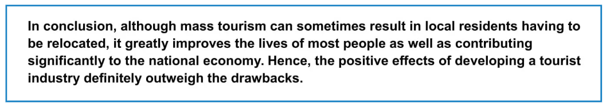
Introduction
Question: A lot of places in the world rely on tourism as a main source of income. Unfortunately, tourism can also be a source of problems if it is not well-managed.
Although holidaymakers contribute hugely to the economies of many popular destinations, the influx of tourists can also cause serious issues. This essay will demonstrate how tourism can transform the economy of poor areas but will also show that this can lead to such problems as the displacement of local people. Whilst acknowledging that there are drawbacks, the essay will argue that the advantages of the tourist industry outweigh the disadvantages.
Conclusion
DO NOT GIVE ANY HEADING
THE HEADINGS OF THE PARAGRAPHS ARE FOR EXPLANATION ONLY
YOUR WRITING SHOULD ONLY HAVE PARAGRAPHS AS SHOWN IN THE LAST SLIDE

Slide 19
Answer

